Slide 1
HEALTH SYSTEM ACHIEVEMENTS AND CHALLENGES GEORGIA
Dr. David Sergeenko
Minister of Labour, Health and Social Affairs
24 January, 2018

Slide 2

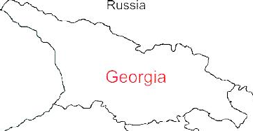



Demographic and Socio-Economic Situation, 2016
Population – 3 719 300
Birth rate (per thousand population) – 15.2
Mortality rate (per thousand population) – 13.7
Life expectancy at birth – 72.7
Maternal Mortality (per 100000 live birth) – 22.9
Infant mortality (per 1000 live birth) – 9.0
Under 5 mortality rate (per 1000 live birth) – 10.7
GDP per capita (at current prices), (2016) – 3852 $US
GDP real growth – 2.7%
Government expenditure on health per capita – 104 $US
Government expenditure on health as % of GDP – 2.8%
Government expenditure on health as % of State Budget – 8%
Government expenditure on health as % of GDP – 3%
General Government expenditure on health per capita (USD) – 116

Slide 3
25 years: Collapse, Stabilization, Acceleration, Development …
Civil war

Slide 4
Economic Growth
3.5 %
Average GDP growth during 2014-2016, when most of Georgia’s neighbors were in or close to recession.
4.8 %
Average economic growth in 11 months of 2017
4.9 %
Average real GDP growth projection in 2018-2022, according to IMF

Slide 5
Unemployment and Poverty Indicators
2016
annual unemployment rate reached its lowest point in 13 years
2009-2016
Decreasing trend of unemployment rate

Slide 6
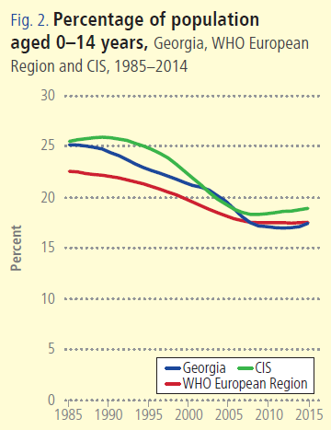
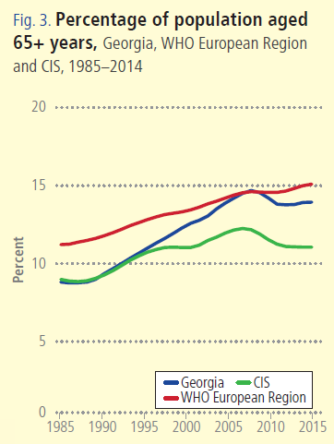

Slide 7
Non-communicable diseases are the primary driver of overall disease burden
Cause of Burden of Disease (DALYs)
Injuries
Communicable
diseases
1990
2005
Non-communicable
diseases
2015

Slide 8
Incidence of TB, Georgia, WHO European Region, CIS, 1990-2016
Incidence of HIV, Georgia, WHO European Region, CIS, 1990-2017
* Data for 2017 are preliminary

Slide 9
Maternal Mortality ratio per 100000 live birth, Georgia, WHO European Region, EU, 2000-2017
Infant Mortality ratio per 1000 live birth, Georgia, WHO European Region, EU, 2000-2017
* Data for 2017 are preliminary

Slide 10
Universal Health Care – Socially Oriented Political Platform
Reforms have moved Georgia closer to universal health coverage
Unprecedented Expansion of State Budget for Health care
365 mill GEL in 2012 → 1017 Mill Gel in 2016
Launch of Universal Health Care Program in February 2013
Better access to care
Better user experience
Better financial protection

Slide 11
Health sector expenditures
Out-of-Pocket Payment as % of Total Health Expenditure, Georgia
Public Health Expenditure, Georgia
Source: Georgia NHA 2010-2016 (MoLHSA, 2017)

Slide 12
Coverage of Healthcare services
Services utilization
Hospitalization per 100 population
UHC Program has led to a major expansion in population entitlement to publicly financed health services (HUES)
Ambulatory care visits per person per years

Slide 13
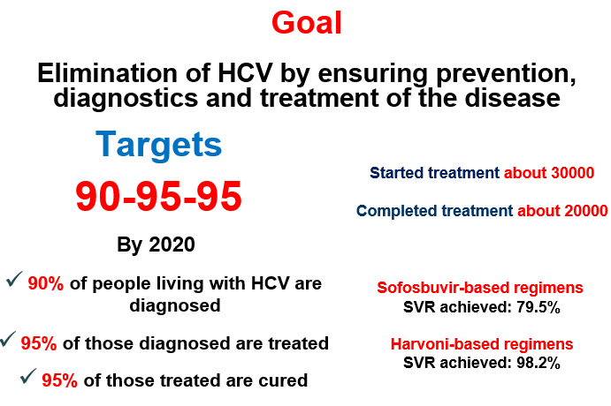
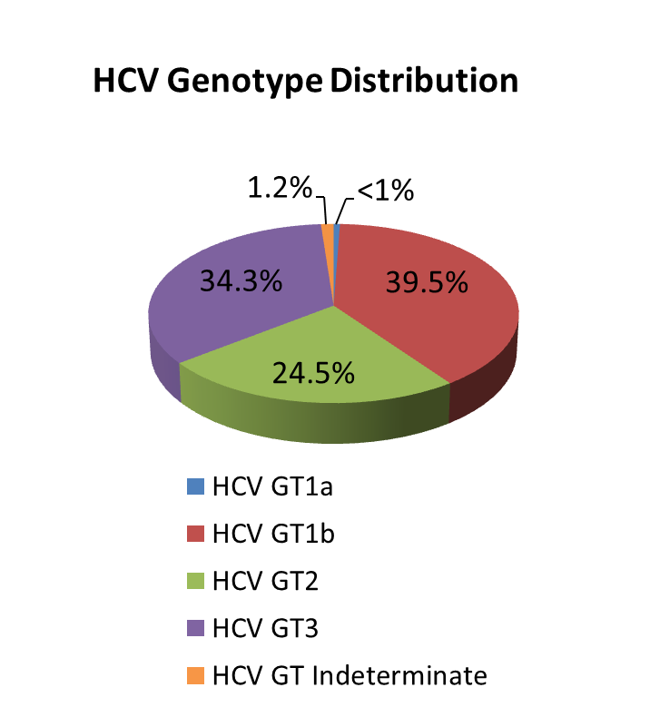
National Hepatitis C Elimination Program
National wide survey, 2015
Anti-HCV+ | 7.7%
HCV RNA+ | 5.4%
Screened - 1,200,00
Started Treatment - 43000
Completed treatment - 37948
Sofosbuvir-based regimens
SVR achieved: 82%
Harvoni-based regimens
SVR achieved: 98.2%

Slide 14

Public health Emergency Preparedness and Responsible Capacity
The revision of Epidemics, Pandemics and Biological Incidents Response Plan
Updating/Developing disease specific plans:
Influenza Response Plan
Ebola virus
Zika Virus
Crimean-Congo Hemorrhagic fever
Polio
Dengue
Emergency Preparedness
WHO IHR was fully implemented in 2012;
NCDC was designated as the national IHR Focal Point;
24/7 Duty Officer System is established;
Georgia, together with other countries is actively involved in support of the 11 Action Package objectives:
Real-Time Surveillance - as a leading country
National Laboratory System – as the contributing country
Zoonotic Diseases – as the contributing country
GHSA
IHR

Slide 15
Main Challenges and future plans…
▪ Still very low public spending on health
Government annually is increase public investment in health care
▪ Expenses on outpatient medications are high
Already started and is continuing expand access to outpatient drugs
▪ Purchasing strategies need improvement for ensuring quality and containing costs
Implement of active purchasing, selective contracting and performance based financing

Slide 16
Thank you for your Attention!

